Slide 1
Computer Graphics
Computer Graphics, Saroj Shakya, Nepal College of Information Technology, Balkumari

Slide 2




Computer Graphics
A field related to the generation of graphics using computers
- It includes the creation, storage and manipulation of images of objects.
Until early 1980’s it was a small specialized field
Hardware was expensive
Graphics based application programs that were easy to use and cost effective were few
PCs with built in raster graphics displays such as the Xerox Star, Apple Macintosh and the IBM PC – popularized the use of bitmap graphics for user computer interaction.
A bitmap is a 1 and 0s representation of the rectangular array of points on the screen.
- Each point is called a pixel, short for “picture elements”.
Computer Graphics, Saroj Shakya, Nepal College of Information Technology, Balkumari

Slide 3


Computer Graphics
Once the bitmap graphics became affordable an explosion of easy to use, inexpensive graphics based user interfaces allowed millions of new users to control simple low cost application programs such as word processors, spreadsheets and drawing programs
The concept of a “desktop” now became popular metaphor for organizing screen space.
Even people who do not use computers encounter computer graphics in TV commercials and as cinematic special effects.
Computer Graphics, Saroj Shakya, Nepal College of Information Technology, Balkumari

Slide 4


Computer Graphics
Thus computer graphics is an integral part of all computer user interfaces, and is indispensable for visualizing 2D, 3D objects in all most all areas such as education , science , engineering, medicine, commerce the military advertizing and entertainment.
The theme is that learning how to program and use computers now includes learning how to use simple 2D graphics
Computer Graphics, Saroj Shakya, Nepal College of Information Technology, Balkumari

Slide 5


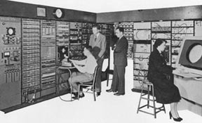
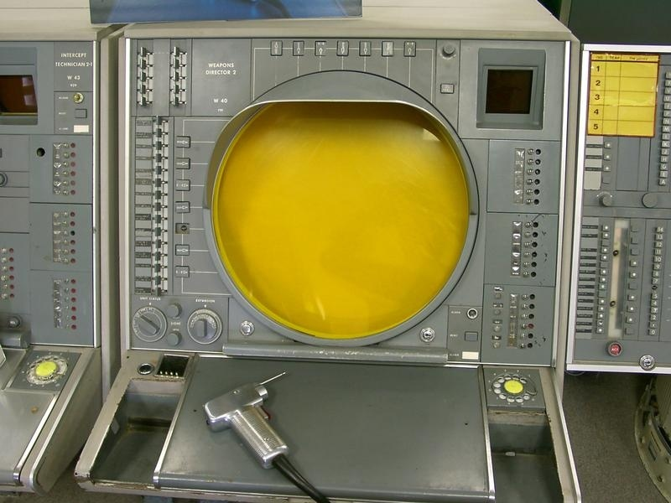
Early History of Computer Graphics
Crude plotting of hardcopy devices such as teletypes and line printers dates from the early days of computing
The whirlwind computer developed in 1950 at the Massachusetts Institute of Technology (MIT) had computer driven CRT displays for output.
Computer Graphics, Saroj Shakya, Nepal College of Information Technology, Balkumari

Slide 6


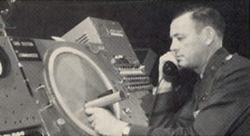
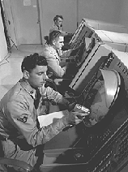
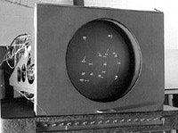
Early History of Computer Graphics
SAGE air-defense system developed in the middle 1950s was the first to use command and control CRT display consoles on which operators identified targets with light pens
(hand held pointing devices that sense light emitted by objects on the screen)
The General Motors DAC system for automobile design and the Itek-Digitek system for lens design
Computer Graphics, Saroj Shakya, Nepal College of Information Technology, Balkumari

Slide 7
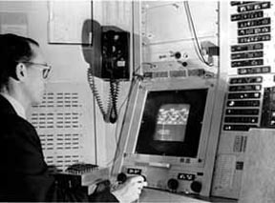



Early History of Computer Graphics
Later on Sketchpad system by Ivan Sutherland came in light.
- The beginning of modern interactive graphics.
- Keyboard and light pen used for pointing, making choices drawing.
Prospects of the use of (CAD) and (CAM) in computer, automobile, and aerospace manufacturing Drafting and Drawing activities.
By the mid 60s, a number of commercial products using these systems had appeared
Computer Graphics, Saroj Shakya, Nepal College of Information Technology, Balkumari

Slide 8




Early History
At that time only the most technology intensive organizations could use the interactive computer graphics where as others used punch cards, a non-interactive system .
Reasons:
The high cost of graphics hardware – at a time when automobiles cost a few thousand dollars, computers cost several millions of dollars, and the first commercial computer displays cost more than a hundred thousand dollars
The need for large scale expensive computing resources to support massive design database
The difficulty of writing large interactive programs using batch oriented FORTRAN programming
Computer Graphics, Saroj Shakya, Nepal College of Information Technology, Balkumari

Slide 9


Early History of Computer Graphics
One of a kind , non-portable software, typically written for a particular manufacturer’s display devices.
( When software is non-portable, moving to new display devices necessitates expensive and time consuming rewriting of working programs)
Thus interactive computer graphics had a limited use when it started in the early sixties but it became very common once the Apple Macintosh and IBM PC appeared in the market with affordable cost
Computer Graphics, Saroj Shakya, Nepal College of Information Technology, Balkumari

Slide 10
Uses of Computer Graphics
Office automation and electronic publishing
User interfaces
Plotting
Art and commerce
Cartography
Computer aided drafting and design
Scientific and business visualization
Entertainment
Simulation
Computer Graphics, Saroj Shakya, Nepal College of Information Technology, Balkumari

Slide 11
Recent Trends of Computer Graphics
Augmented Reality
    Interactive user experience thru superimposing of computer generated information along with real world scenario
GAN
  computer graphics, such as content creation, style transfer, image synthesis, face manipulation, and animation.
Live action Film making
  motion capture, green screens, LED walls, and VR headsets.

Slide 12
Recent Trends of Computer Graphics
Machine learning for computer graphics
  image processing
  computer vision
  natural language processing
  audio synthesis
  data analysis.
Animations and Morphing

Slide 13
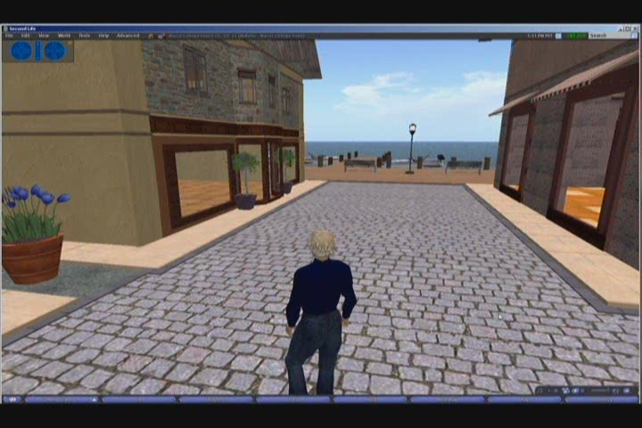
Computer Graphics, Saroj Shakya, Nepal College of Information Technology, Balkumari

Slide 14
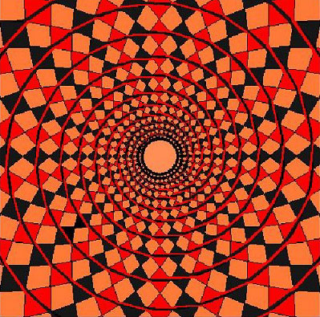
Computer Graphics, Saroj Shakya, Nepal College of Information Technology, Balkumari

Slide 15
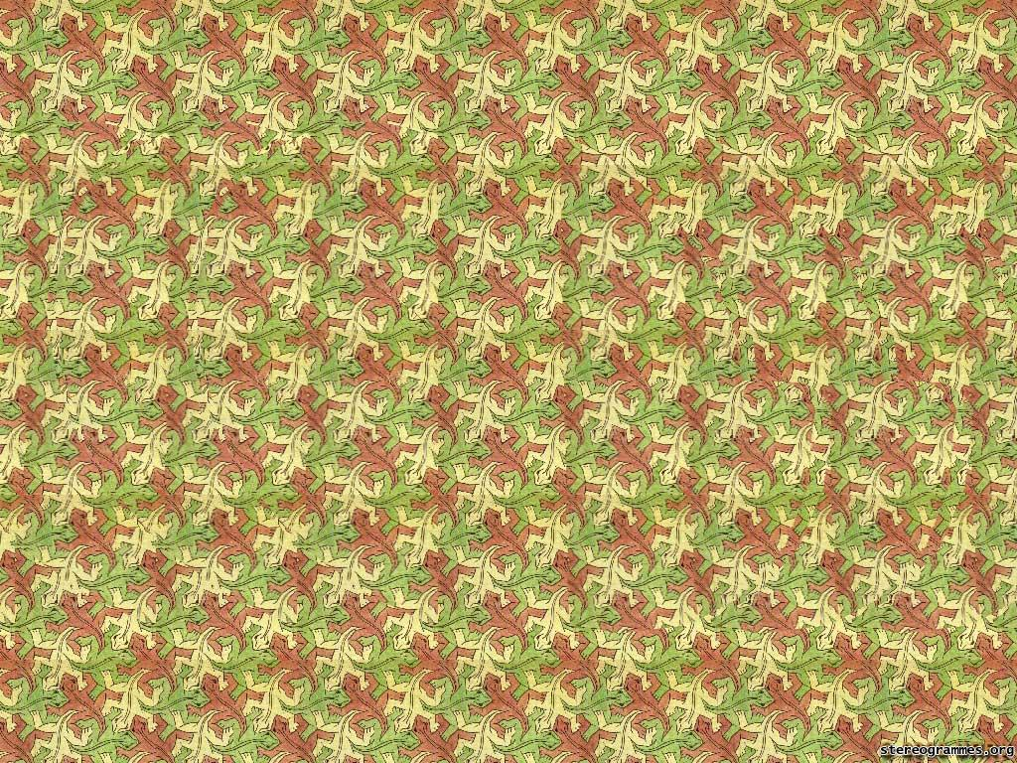
Computer Graphics, Saroj Shakya, Nepal College of Information Technology, Balkumari

Slide 16
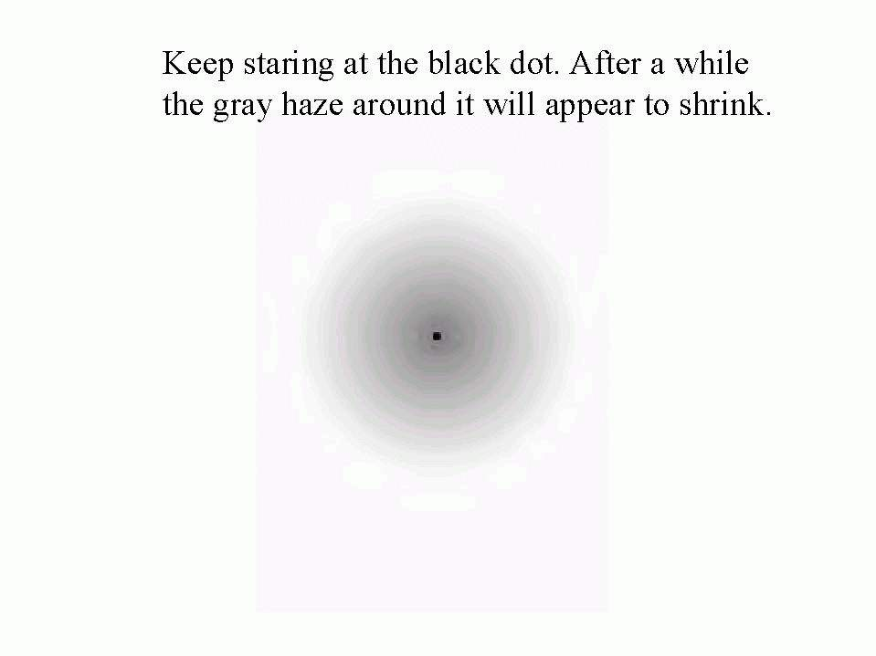
Computer Graphics, Saroj Shakya, Nepal College of Information Technology, Balkumari

Slide 17

Computer Graphics, Saroj Shakya, Nepal College of Information Technology, Balkumari

Slide 18
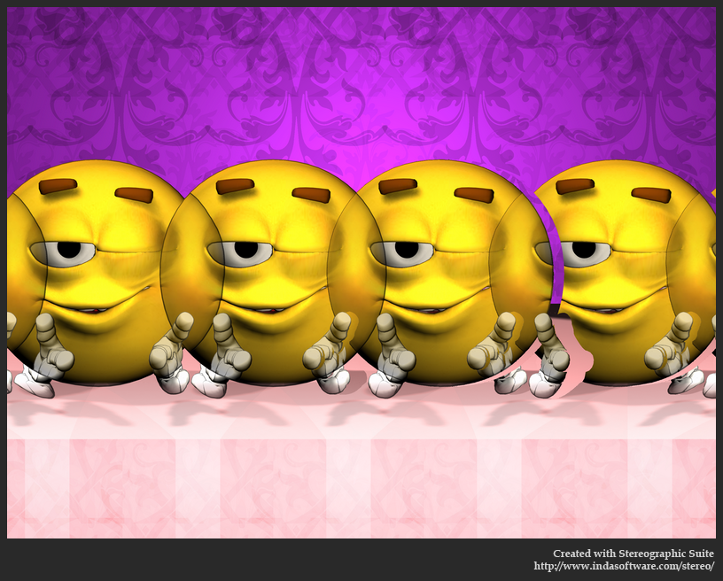
Computer Graphics, Saroj Shakya, Nepal College of Information Technology, Balkumari

Slide 19

Computer Graphics, Saroj Shakya, Nepal College of Information Technology, Balkumari

Slide 20
Computer Graphics, Saroj Shakya, Nepal College of Information Technology, Balkumari

Slide 21
Input Hardware
Tablet
Tablet a tablet is a digitizer.
- scan over an object and input a set of discrete coordinate positions.
These positions can then be joined with straight line segments to approximate the shape of the original object.
A tablet digitizes an object detecting the position of a movable stylus (a pencil shaped device) or a puck(a mouse like device with cross hairs for sighting positions) held in the user’s hand
Computer Graphics, Nepal College of Information Technology, 2009

Slide 22
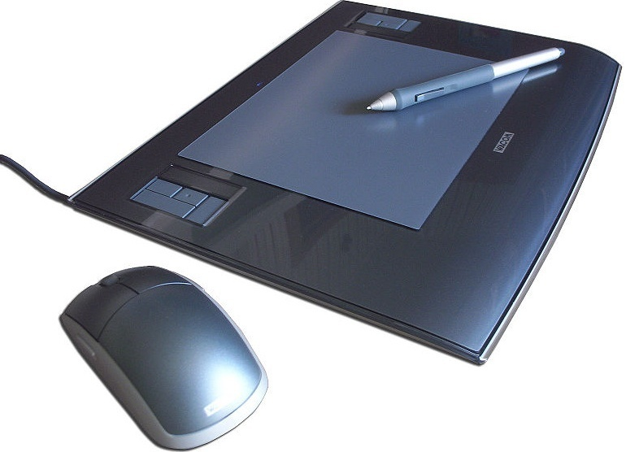
Input Hardware
Computer Graphics, Nepal College of Information Technology, 2009

Slide 23
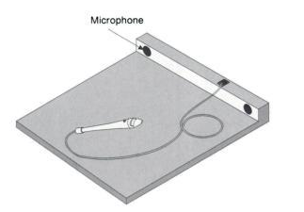
Input Hardware
i. Electrical Tablet
ii. Sonic Tablet
iii. Resistive Tablet
Computer Graphics, Nepal College of Information Technology, 2009

Slide 24
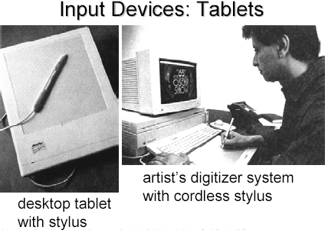
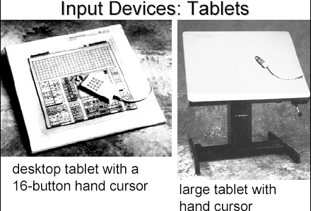
Computer Graphics, Nepal College of Information Technology, 2009

Slide 25
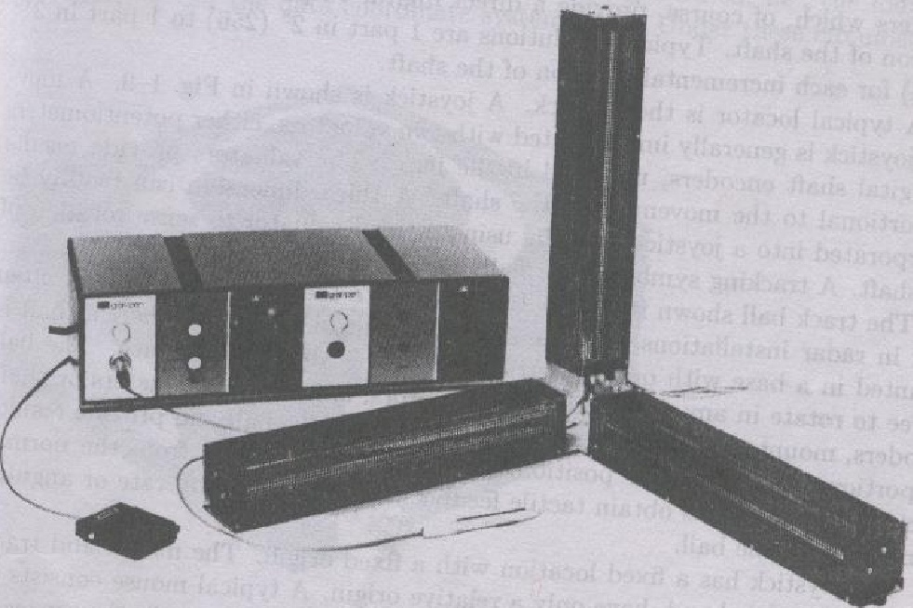
Computer Graphics, Nepal College of Information Technology, 2009

Slide 26
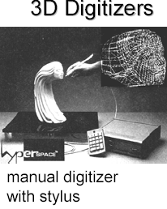
Computer Graphics, Nepal College of Information Technology, 2009

Slide 27
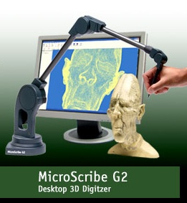
Computer Graphics, Nepal College of Information Technology, 2009

Slide 28
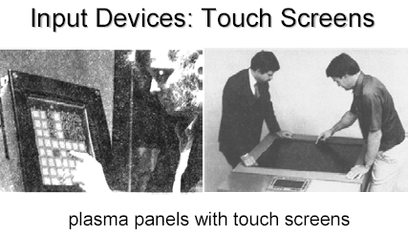
Input Hardware
Touch Panels
The touch panel allows the user to point at the screen directly with a finger to move the cursor around the screen or to select the icons.
Optical Touch Panel
Sonic Touch Panel
Electrical Touch Panel
Computer Graphics, Nepal College of Information Technology, 2009

Slide 29
Input Hardware
Light pen
It is a pencil shaped device to determine the coordinates of a point on the screen where it is activated such as pressing the button .
In raster display ‘y’ is set at y_{max} and ‘x’ changes from 0 to x_{max} the first scan line .
For the second line ‘y’ decreases by one and ‘x’ again changes from 0 to x_{max} and so on
When activated light pen sees a burst of light at certain position as the electron beam hits the phosphor coating at that position it generates an electric pulse
Computer Graphics, Nepal College of Information Technology, 2009

Slide 30
Input Hardware
This is used to save the video controller’s ‘x’ and ‘y’ registers and interrupt the computer
By reading the saved valued the graphics package can determine the coordinates of the position seen by the light pen
Drawbacks
i. Light pen obscures screen images as it is pointed to required spot
ii. Prolong use of it can cause arm fatigue
iii. It cannot report the coordinates of a point that is completely black as a remedy one can display a dark blue field in place of the regular image for a single frame time
iv. It gives sometimes false reading due to back ground lighting in a room
Computer Graphics, Nepal College of Information Technology, 2009

Slide 31
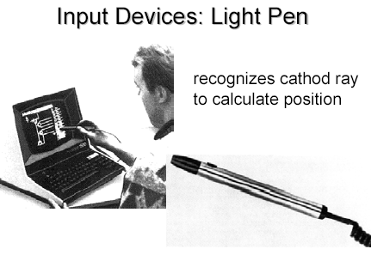
Computer Graphics, Nepal College of Information Technology, 2009

Slide 32
Display Devices
Fluorescence / Phosphorescence
A phosphors fluorescence is the light emitted as the very unstable electrons lose their excess energy whole the phosphor is being struck by electrons
Phosphorescence is the light given off by the return of the relatively more stable excited electrons to their unexcited state once the electron beam excitation is removed
Computer Graphics, Nepal College of Information Technology, 2009

Slide 33
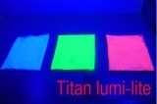
Display Devices
Persistence
A phosphor’s persistence is defined as the time from the removal of excitation to the moment when phosphorescence has decay to 10 percent of the initial light output
The range of persistence of different phosphors can reach many seconds
The phosphors used for graphics display devices usually have persistence of 10 to 60 micro seconds
A phosphor with low persistence is useful for animation and a high persistence phosphor is useful to highly complex static pictures
Computer Graphics, Nepal College of Information Technology, 2009

Slide 34
Display Devices
The factors affecting the CFF are:
i. Persistence: longer the persistence the lower the CFF But the relation between the CFF and persistence is non linear
ii. Image intensity: Increasing the image intensity increases the CFF with non linear relationship
iii. Ambient room light Decreasing the ambient room light increases the CFF with nonlinear relationship
iv. Wave lengths of emitted light
v. Observer
Computer Graphics, Nepal College of Information Technology, 2009

Slide 35
Display Devices
Refresh rate
The refresh rate is the number of times per second the image is redrawn to give a feeling of un-flickering pictures and it is usually 50 per second
As the refresh rate decreases flicker develops because the eye can no longer integrate the individual light impulses coming from a pixel
The refresh rate above which a picture stops flickering and fuses into a steady image is called the critical fusion frequency (CFF)
Computer Graphics, Nepal College of Information Technology, 2009

Slide 36

Display Devices
Resolution
Resolution is defined as the maximum number of points that can be displayed horizontally and vertically with out overlap on a display device
Factors affecting the resolution are as follows
i. Spot profile:
The spot intensity has a Gaussian distribution. So two adjacent spots on the display device appear distinct as long as their separation D₂ is greater than the diameter of the spot D₁ at which each spot has an intensity of about 60 percent of that at the center of the spot
Intensity 60%
D₁
D₂
Computer Graphics, Nepal College of Information Technology, 2009

Slide 37
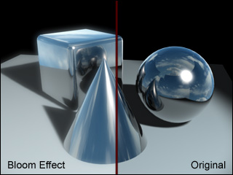
Display Devices
Intensity:
As the intensity of the electron beam increases the spot size on the display tends to increase because of spreading of energy beyond the point of bombardment
This phenomenon is called blooming Consequently , the resolution decreases.
Thus it is noted that resolution is no necessarily a constant and it is not necessarily equal to the resolution of a pix-map, which is allocated in a buffer memory
Computer Graphics, Nepal College of Information Technology, 2009

Slide 38
Display Devices
Color CRTs
Color depends on the light emitted by phosphor.
Two type:
Beam Penetration Method
Shadow Mask Method
Computer Graphics, Nepal College of Information Technology, 2009

Slide 39
Display Devices
i. Beam Penetration Method:
Two different layers of phosphor coating used Red (outer) and Green
(inner)
Display of color depends on the depth of penetration of the electron beam
into the phosphor layers
A beam of slow electrons excites only the outer red layer
A beam of very fast electrons penetrates thru the red phosphor and excites
the inner green layer
When quantity of red is more than green then color appears as orange
When quantity of green is more than red then color appears as yellow
Screen color is controlled by the beam acceleration voltage.
Only four colors possible, poor picture quality
Computer Graphics, Nepal College of Information Technology, 2009

Slide 40
Display Devices
ii. Shadow Mask Method
The inner side of the viewing surface of a color CRT consists of closely spaced groups of red, green and blue phosphor dots.
Each group is called a triad
A thin metal plate perforated with many small holes is mounted close to the inner side of the viewing surface. This plate is called shadow mask
The shadow mask is mounted in such a way that each hole is correctly aligned with a triad in color CRT
Computer Graphics, Nepal College of Information Technology, 2009

Slide 41
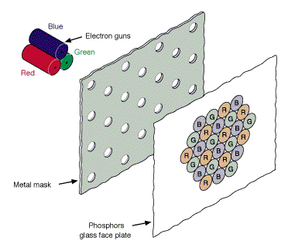
Display Devices
There are three electron guns one for each dot in a triad
The electron beam form each gun therefore hits only the corresponding dot of a triad as the three electron beams deflect
A triad is so small that light emanating from the individual dots is perceived by the viewer as a mixture of the three colors
Thus, a wide range of colors can be produced by each triad depending on how strongly each individual phosphor dot in a triad is excited.
Computer Graphics, Nepal College of Information Technology, 2009

Slide 42
Display Devices
a. A Delta –Delta CRT
A triad has a triangular (delta) pattern as are the three electron guns
Main drawback of this type of CRT is that a high precision display is very difficult to achieve because of technical difficulties involved in the alignment of shadow mask holes and the triad on one to one basis
b. Precision Inline CRT
A triad has an in-line pattern as are the three electron guns
The introduction of this type of CRT has eliminated the main drawback of a Delta-Delta CRT
But a slight reduction of image sharpness at the edges of the tube has been noticed
Normally 1000 scan lines can be achieved
Computer Graphics, Nepal College of Information Technology, 2009

Slide 43
i. Vector Display Technology
CPU
Peripheral Devices
System Bus
System Memory
Display Processor
Monitor
.
.
MoveTo(10,10)
LineTo(639,479)
.
.
.
Display List ->
Computer Graphics, Nepal College of Information Technology, 2009

Slide 44
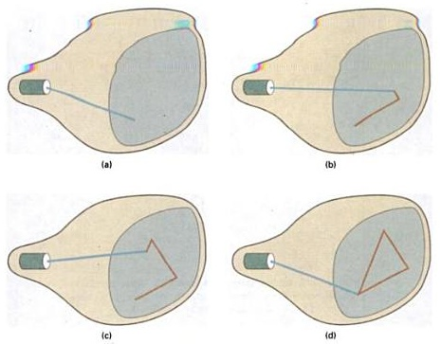
i. Vector Display Technology
Computer Graphics, Nepal College of Information Technology, 2009

Slide 45
i. Vector Display Technology
It is also called random scan, a stroke, a line drawing or calligraphic display
Advantages:
i. It can produce a smooth output primitives with higher resolution unlike the raster display technology
ii. It is better than raster display for real time dynamics such as animation
iii. For transformation, only the end points has to be moved to the new position in vector display but in raster display it is necessary to move those end points and at the same time all the pixels between the end points must be scan converted using appropriate algorithm
No prior information on pixels can be reused
Computer Graphics, Nepal College of Information Technology, 2009

Slide 46
i. Vector Display Technology
Disadvantages:
i. A vector display can not fill areas with patterns and manipulate bits
ii. Time required for refreshing an image depends upon its complexity (more the lines, longer the time) the flicker may therefore appear as the complexity of the image increases. The fastest vector display can draw about 100000 short vectors in a refresh cycle without flickering
Computer Graphics, Nepal College of Information Technology, 2009

Slide 47
ii. Raster Display Technology
CPU
Peripheral Devices
System Bus
System Memory
Video Controller
Monitor
0 0 0 0 0 0 0 0 0 0 0 1 0 0 0 0 0 0 0 0
0 0 1 0 0 0 0 0 0 0
0 0 0 1 0 0 0 0 0 0
0 0 0 0 1 0 0 0 0 0
Frame Buffer ->
Computer Graphics, Nepal College of Information Technology, 2009

Slide 48
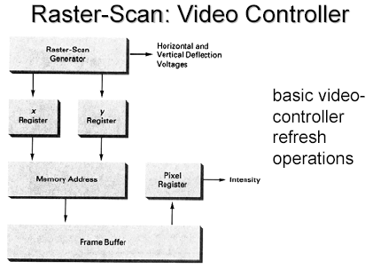
ii. Raster Display Technology
Computer Graphics, Nepal College of Information Technology, 2009

Slide 49
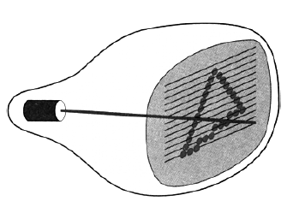
ii. Raster Display Technology
Computer Graphics, Nepal College of Information Technology, 2009

Slide 50
ii. Raster Display Technology
Advantages
i. It has an ability to fill the areas with solid colors or patterns
ii. The time required for refreshing is independent of the complexity of the image
iii. Low cost
Computer Graphics, Nepal College of Information Technology, 2009

Slide 51
ii. Raster Display Technology
Disadvantages
i. For Real-Time dynamics not only the end points are required to move but all the pixels in between the moved end points have to be scan converted with appropriate algorithms which might slow down the dynamic process
ii. Due to scan conversion “jaggies” or “stair-casing” are unavoidable
Computer Graphics, Nepal College of Information Technology, 2009

Slide 52
RDT/VDT
Computer Graphics, Nepal College of Information Technology, 2009

Slide 53
Frame Buffer
0 0 0 0 0 0 0 0 0 0 0 1 0 0 0 0 0 0 0 0
0 0 1 0 0 0 0 0 0 0
0 0 0 1 0 0 0 0 0 0
0 0 0 0 1 0 0 0 0 0
Screen
0
Electron
Gun
Frame Buffer
Computer Graphics, Nepal College of Information Technology, 2009

Slide 54
Frame Buffer
0 0 0 0 0 0 0 0 0 1 0 1 0 0 0 0 0 0 0 0
0 0 1 0 0 0 0 0 0 0
0 0 0 1 0 0 0 0 0 0
0 0 0 0 1 0 0 0 0 0
Screen
1
Electron
Gun
Frame Buffer
Computer Graphics, Nepal College of Information Technology, 2009

Slide 55
Frame Buffer
0 0 0 0 0 0 0 0 0 1 0 1 0 0 0 0 0 0 0 0
0 0 1 0 0 0 0 0 0 0
0 0 0 1 0 0 0 0 0 0
0 0 0 0 1 0 0 0 0 0
1
r
Screen
0 0 0 0 0 0 0 0 0 1 0 1 0 0 0 0 0 0 0 0
0 0 1 0 0 0 0 0 0 0
0 0 0 1 0 0 0 0 0 0
0 0 0 0 1 0 0 0 0 0
1
0 0 0 0 0 0 0 0 0 0 0 1 0 0 0 0 0 0 0 0
0 0 1 0 0 0 0 0 0 0
0 0 0 1 0 0 0 0 0 0
0 0 0 0 1 0 0 0 0 0
0
Electron
Guns
Frame Buffer
Computer Graphics, Nepal College of Information Technology, 2009

Slide 56
Frame Buffer
0 0 0 0 0 0 0 0 0 1 0 1 0 0 0 0 0 0 0 0
0 0 1 0 0 0 0 0 0 0
0 0 0 1 0 0 0 0 0 0
0 0 0 0 1 0 0 0 0 0
1
r
Screen
0 0 0 0 0 0 0 0 0 1 0 1 0 0 0 0 0 0 0 0
0 0 1 0 0 0 0 0 0 0
0 0 0 1 0 0 0 0 0 0
0 0 0 0 1 0 0 0 0 0
1
0 0 0 0 0 0 0 0 0 1 0 1 0 0 0 0 0 0 0 0
0 0 1 0 0 0 0 0 0 0
0 0 0 1 0 0 0 0 0 0
0 0 0 0 1 0 0 0 0 0
1
Electron
Guns
Frame Buffer
Computer Graphics, Nepal College of Information Technology, 2009

Slide 57
Frame Buffer
0 0 0 0 0 0 0 0 0 1 0 1 0 0 0 0 0 0 0 0
0 0 1 0 0 0 0 0 0 0
0 0 0 1 0 0 0 0 0 0
0 0 0 0 1 0 0 0 0 0
0 0 0 0 0 0 0 0 0 1 0 1 0 0 0 0 0 0 0 0
0 0 1 0 0 0 0 0 0 0
0 0 0 1 0 0 0 0 0 0
0 0 0 0 1 0 0 0 0 0
0 0 0 0 0 0 0 0 0 1 0 1 0 0 0 0 0 0 0 0
0 0 1 0 0 0 0 0 0 0
0 0 0 1 0 0 0 0 0 0
0 0 0 0 1 0 0 0 0 0
0 0 0 0 0 0 0 0 0 1 0 1 0 0 0 0 0 0 0 0
0 0 1 0 0 0 0 0 0 0
0 0 0 1 0 0 0 0 0 0
0 0 0 0 1 0 0 0 0 0
0 0 0 0 0 0 0 0 0 1 0 1 0 0 0 0 0 0 0 0
0 0 1 0 0 0 0 0 0 0
0 0 0 1 0 0 0 0 0 0
0 0 0 0 1 0 0 0 0 0
0 0 0 0 0 0 0 0 0 1 0 1 0 0 0 0 0 0 0 0
0 0 1 0 0 0 0 0 0 0
0 0 0 1 0 0 0 0 0 0
0 0 0 0 1 0 0 0 0 0
0 0 0 0 0 0 0 0 0 1 0 1 0 0 0 0 0 0 0 0
0 0 1 0 0 0 0 0 0 0
0 0 0 1 0 0 0 0 0 0
0 0 0 0 1 0 0 0 0 0
1 1 1 1 1 1 1 1
Screen
0 0 0 0 0 0 0 0 0 1 0 1 0 0 0 0 0 0 0 0
0 0 1 0 0 0 0 0 0 0
0 0 0 1 0 0 0 0 0 0
0 0 0 0 1 0 0 0 0 0
0 0 0 0 0 0 0 0 0 1 0 1 0 0 0 0 0 0 0 0
0 0 1 0 0 0 0 0 0 0
0 0 0 1 0 0 0 0 0 0
0 0 0 0 1 0 0 0 0 0
0 0 0 0 0 0 0 0 0 1 0 1 0 0 0 0 0 0 0 0
0 0 1 0 0 0 0 0 0 0
0 0 0 1 0 0 0 0 0 0
0 0 0 0 1 0 0 0 0 0
0 0 0 0 0 0 0 0 0 1 0 1 0 0 0 0 0 0 0 0
0 0 1 0 0 0 0 0 0 0
0 0 0 1 0 0 0 0 0 0
0 0 0 0 1 0 0 0 0 0
Electron
Guns
0 0 0 0 0 0 0 0 0 1 0 1 0 0 0 0 0 0 0 0
0 0 1 0 0 0 0 0 0 0
0 0 0 1 0 0 0 0 0 0
0 0 0 0 1 0 0 0 0 0
0 0 0 0 0 0 0 0 0 1 0 1 0 0 0 0 0 0 0 0
0 0 1 0 0 0 0 0 0 0
0 0 0 1 0 0 0 0 0 0
0 0 0 0 1 0 0 0 0 0
1 1 1 1 1 1 1 1
Frame Buffer
0 0 0 0 0 0 0 0 0 0 0 1 0 0 0 0 0 0 0 0
0 0 1 0 0 0 0 0 0 0
0 0 0 1 0 0 0 0 0 0
0 0 0 0 1 0 0 0 0 0
0 0 0 0 0 0 0 0 0 1 0 1 0 0 0 0 0 0 0 0
0 0 1 0 0 0 0 0 0 0
0 0 0 1 0 0 0 0 0 0
0 0 0 0 1 0 0 0 0 0
0 0 0 0 0 0 0 0 0 1 0 1 0 0 0 0 0 0 0 0
0 0 1 0 0 0 0 0 0 0
0 0 0 1 0 0 0 0 0 0
0 0 0 0 1 0 0 0 0 0
0 0 0 0 0 0 0 0 0 1 0 1 0 0 0 0 0 0 0 0
0 0 1 0 0 0 0 0 0 0
0 0 0 1 0 0 0 0 0 0
0 0 0 0 1 0 0 0 0 0
0 0 0 0 0 0 0 0 0 1 0 1 0 0 0 0 0 0 0 0
0 0 1 0 0 0 0 0 0 0
0 0 0 1 0 0 0 0 0 0
0 0 0 0 1 0 0 0 0 0
0 0 0 0 0 0 0 0 0 1 0 1 0 0 0 0 0 0 0 0
0 0 1 0 0 0 0 0 0 0
0 0 0 1 0 0 0 0 0 0
0 0 0 0 1 0 0 0 0 0
1 1 1 1 1 1 1 1
Computer Graphics, Nepal College of Information Technology, 2009

Slide 58
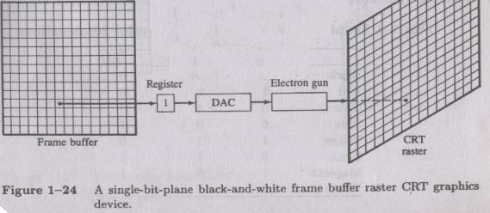
Computer Graphics, Nepal College of Information Technology, 2009

Slide 59
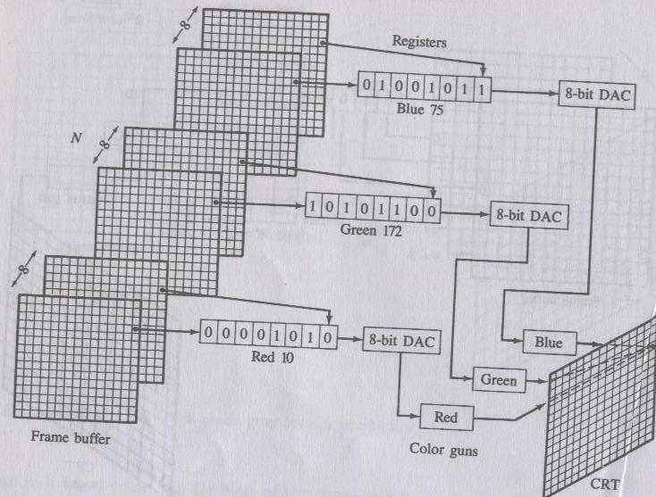
Computer Graphics, Nepal College of Information Technology, 2009

Slide 60
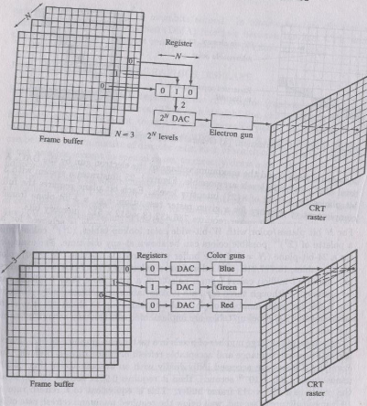
Computer Graphics, Nepal College of Information Technology, 2009

Slide 61
Refresh rate
  When electron beam strikes a dot in CRT, the surface of the CRT only glows for a fraction of a second and then fades.
  Monitor must redraw the picture many times per second to avoid having the screen flicker
Computer Graphics, Nepal College of Information Technology, 2009

Slide 62
Video Cards and CRT Monitors
On an average it takes 200 nano second to access a pixel value from the frame buffer and glow a phosphor dot on the screen for a Raster System. If total resolution of the screen is 1024 x 1024, will this access rate create a flickering effect on the screen?
In case of a Raster display, a color monitor with a maximum resolution of 640 x 480 is capable of displaying RGB color with 256 intensity levels thru a single pixel (composed of red , green and blue component). What is the required size of the frame buffer in this case?
A Raster systems has a resolution of 640 by 480, How many pixels could be accessed per second in this system by a display controller that refreshes the screen at a rate of 45frames per second?
Computer Graphics, Nepal College of Information Technology, 2009

Slide 63
Video Cards and CRT Monitors
How long would it take to load a 640 by 480 frame buffer with 12 bits per pixel, if 10⁵ bits can be transferred per second? How long would it take to load a 24-bit per pixel frame buffer with a resolution of 1280 by 1024 using this same transfer rate?
Consider two raster systems with resolutions of 640 by 480 and 1280 by 1024. How many pixels could be accessed per second in each of these systems by a display controller that refreshes the screen at a rate of 60 frames per second? What is the access time per pixel in each system?
Computer Graphics, Nepal College of Information Technology, 2009

Slide 64
Refresh rate
  The refresh rate is the number of times per second that monitor redraws the images on the screen.
  Very few people notice flicker at refresh rates above 72 Hz.
  Higher refresh rates are preferred for better comfort in viewing the monitor
Computer Graphics, Nepal College of Information Technology, 2009

Slide 65
Quality of a CRT Monitor
Depends largely on its resolution, dot pitch, and refresh rate
Resolution describes the sharpness and clearness of an image
Manufacturers state the resolution of a monitor in pixel
  Example: 800 X 600
A pixel (picture element) is a single point in an electronic image
  A pixel is the smallest element in an electronic image
Computer Graphics, Nepal College of Information Technology, 2009

Slide 66
Video Cards and CRT Monitors
Many CRT monitors use an analog signal to produce an image
Video card converts digital output from the computer into an analog video signal and sends the signal through a cable to the monitor
  Also called a graphics card
Computer Graphics, Nepal College of Information Technology, 2009

Slide 67
Video Cards and CRT Monitors
The number of colors a video card displays is determined by its bit depth
The video card’s bit depth, also called the color depth, is the number of bits it uses to store information about each pixel
i.e. 8-bit video card uses 8 bits to store information about each pixel; this video card can display 256 colors (2x2x2x2x2x2x2x2)
i.e. 24-bit video card uses 24 bits to store information about each pixel and can display 16.7 million colors
The greater the number of bits, the better the resulting image
Computer Graphics, Nepal College of Information Technology, 2009

Slide 68
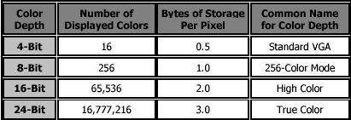
Computer Graphics, Nepal College of Information Technology, 2009

Slide 69
Video Display StandardsVideo Electronics Standards Association (VESA), which consists of video card and monitor manufacturers, develops video stands to define the resolution, number of colors, and other display properties.
  Monochrome Display Adapter (MDA)
  Hercules Graphics Card
  Color Graphics Adapter (CGA)
  Enhanced Graphics Adapter (EGA)
  Video Graphics Adapter (VGA)
  Super VGA (SVGA) and Other Standards Beyond VGA
Computer Graphics, Nepal College of Information Technology, 2009

Slide 70
Line Drawing
Point plotting is accomplished by converting a single coordinate position by an application program into approximate operation for the output device in use.
CRT electron beam is turned on to illuminate the screen phosphor at selected location.
Computer Graphics, Nepal College of Information Technology, 2009

Slide 71
Line Drawing
In random scan system, point plotting commands are stored in display list and coordinate values in these instructions are converted to deflection voltages that position the electron beam at that screen location to be plotted during each refresh cycle.
In case of black and white raster scan system a point is plotted by setting the bit value corresponding to specified screen position within frame buffer to 1.
Computer Graphics, Nepal College of Information Technology, 2009

Slide 72
Line Drawing
For drawing lines, we need to calculate intermediate positions along the line path between two end points
e.g. 10.45 is rounded off to 10 (this causes stair cases or jaggies to be formed)
To load intensity value into frame buffer at position x, y we use function
setpixel (x, y, intensity)
To retrieve current frame buffer intensity value for specified location we use getpixel(x,y)
4
3
?
2
?
1
1
2
3
4
Computer Graphics, Nepal College of Information Technology, 2009

Slide 73
DDA (Digital Differential Analyzer)
Slope intercept equation of a straight line is y = m x +c
For points (x1, y1) and (x2,y2) slope m = y2 – y1/x2 - x1 or Δy/Δx
Algorithms for displaying lines depend on these equations for given interval x we can compute y interval
Δy = m . Δx
‘x’ interval Δx is obtained by Δx = Δy/m
These equations form the basis for determining deflection voltages in analog devices
Computer Graphics, Nepal College of Information Technology, 2009

Slide 74
DDA (Digital Differential Analyzer)
For lines with slope m = 1, Δy and Δx are equal
DDA scan conversion algorithm is based on calculating Δx, Δy
We sample line at unit interval in one coordinate and determine corresponding integer values nearest the line path for other coordinate
Computer Graphics, Nepal College of Information Technology, 2009

Slide 75
DDA (Digital Differential Analyzer)
Positive Slope
For slope < 1
x > y
y_{k+1} – y_{k} = m
or y_{k+1} = y_{k} + m
y_{k+1}
y
x_{k}
x_{k+1}
Moving from left to right
Computer Graphics, Nepal College of Information Technology, 2009

Slide 76
DDA (Digital Differential Analyzer)
Positive Slope
For slope > 1
y > x
x_{k+1} – x_{k} = 1/m
or x_{k+1} = x_{k} + 1/m
y_{k+1}
y_{k}
x_{k}
x_{k+1}
Moving from left to right
Computer Graphics, Nepal College of Information Technology, 2009

Slide 77
DDA (Digital Differential Analyzer)
Negative Slope
For slope < 1
y > x
y_{k+1} – y_{k} = m
or y_{k+1} = y_{k} + m
y_{k+1}
y_{k}
x_{k}
x_{k+1}
Moving from left to right
Computer Graphics, Nepal College of Information Technology, 2009

Slide 78
DDA (Digital Differential Analyzer)
Negative Slope
For slope > 1
y > x
or x_{k+1} = x_{k} – m ?
y_{k+1}
y_{k}
x_{k}
x_{k+1}
Moving from left to right
Computer Graphics, Nepal College of Information Technology, 2009

Slide 79
DDA (Digital Differential Analyzer)
Advantages:
Accurate
Disadvantages :
Slower as it uses floating point arithmetic
Computer Graphics, Nepal College of Information Technology, 2009

Slide 80
Bresenham’s Line Drawing Algorithm
Accurate and easier line drawing algorithm by Bresenham
Vertical axis: scan line
Horizontal axis: pixel column
For slope < 1 sample at unit ‘x’ interval in ‘x’ direction, determine which of the two possible pixel positions is closer to the line path at each sample step.
Bresenham’s algorithm gives the solution to this problem by testing the sign of the integer parameter whose value is proportional to difference between the separation of two pixel positions from actual line path.
Computer Graphics, Nepal College of Information Technology, 2009

Slide 81
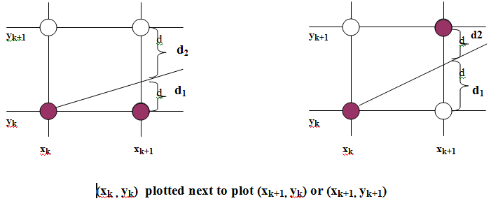
Line Drawing
Computer Graphics, Nepal College of Information Technology, 2009

Slide 82
Line Drawing
Algorithm for 0<m<1
  Input the two line endpoints and store the left end point in (x₀, y₀)
  Load (x₀, y₀) into the frame buffer; that is, plot the first point
  Calculate constants Δx, Δy, 2Δy, and 2Δy− 2Δx, and obtain the starting value for the decision parameter as
  At each x_{k} along the line, start at k =0, perform the following test:
    If p_{k} < 0, the next point to plot is (x_{k}+1, y_{k}) and
    Otherwise, the next point to plot is (x_{k}+1, y_{k}+1) and
  Repeat step 4 Δx times
Computer Graphics, Nepal College of Information Technology, 2009

Slide 83
Dot Pitch
  The distance between adjacent sets of red, green and blue dots.
  The dot pitch of the monitor indicates how fine the dots are that make up the picture.
  The smaller the dot pitch, the more sharp and detailed the image.
Computer Graphics, Nepal College of Information Technology, 2009

Slide 84
Filled Area Primitives
Standard output primitive in graphics packages is solid color ,patterned polygon area
Polygons are easier to process due to linear boundaries
Two basic approaches to area filling on a raster system
1. Determine the overlap intervals for scan lines that cross the area.
Typically useful for filling polygons, circles, ellipses
2.Start from a given interior position and paint outwards from
this point until we encounter the specified boundary conditions
useful for filling more complex boundaries, interactive painting
system.
Computer Graphics, Nepal College of Information Technology, 2009

Slide 85
Filling rectangles
Two things to consider
i. which pixels to fill
ii. with what value to fill
Move along scan line (from left to right) that intersect the primitive and fill in pixels that lay inside
To fill rectangle with solid color
Set each pixel lying on scan line running from left edge to right with same
pixel value, each span from x _{max} to x _{min}
for( y from y _{min} to y _{max} of rectangle) /*scan line*/
for( x from x _{min} to x _{max} of rectangle) /*by pixel*/
writePixel(x, y, value);
Computer Graphics, Nepal College of Information Technology, 2009

Slide 86
Filling Polygons
Filling Polygons
  Scan-line fill algorithm
    Inside-Outside tests
  Boundary fill algorithm
11
1
2
3
4
5
6
7
8
9
10
5
6
7
8
9
4
3
1
2
Computer Graphics, Nepal College of Information Technology, 2009

Slide 87
Topological Difference between 2 Scan lines
  y : intersection edges are opposite sides
  y’ : intersection edges are same side
y
1
2
2
y’
1
1
Computer Graphics, Nepal College of Information Technology, 2009

Slide 88
Topological Difference between 2 Scan lines
  y : intersection edges are opposite sides
  y’ : intersection edges are same side
y
1
2
2
y’
1
1
Computer Graphics, Nepal College of Information Technology, 2009

Slide 89
Edge Sorted Table
B
y_{C}
y_{B}
x_{C}
1/m_{CB}
C
C’
E
y_{D}
y_{C’}
x_{D}
1/m_{DC}
y_{E}
x_{D}
1/m_{DE}
D
y_{A}
y_{E}
x_{A}
1/m_{AE}
y_{B}
x_{A}
1/m_{AB}
A
1
Scan-Line Number
0
Computer Graphics, Nepal College of Information Technology, 2009

Slide 90
Proceed to Neighboring Pixels
  4-Connected
  8-Connected
Computer Graphics, Nepal College of Information Technology, 2009

Slide 91
Boundary Fill
Start at a point inside a region and paint the interior outward toward the boundary.
If boundary is specified in a single color the fill algorithm proceeds outward pixel by pixel until the boundary color is encountered
Accepts as input coordinates of an interior point (x, y) a fill color and boundary color.
Starting from (x, y) the procedure tests neighboring position to determine whether they are of the boundary color.
If not they are painted with fill color and their neighbors are tested
Process continues until all pixels up to boundary color for the area have been tested
Computer Graphics, Nepal College of Information Technology, 2009

Slide 92
boundaryFill(int x,y,fill_color, boundary_color){
int color;
getpixel(x,y,color)
if(color != boundary_color AND color != fill_color ){
setpixel( x,y,fill_color)
boundaryFill( x+1,y,fill_color, boundary_color)
boundaryFill( x,y+1,fill_color, boundary_color)
boundaryFill( x-1,y,fill_color, boundary_color)
boundaryFill( x,y-1,fill_color, boundary_color)
}
}
Computer Graphics, Nepal College of Information Technology, 2009

Slide 93
Flood Fill
Filling an area that is not defined within a single color boundary.
In this case replace a specified interior color instead of searching for boundary color value.
Start from specified interior point (x , y) and reassign all pixel values that are currently set to a given interior color with the desired color.
If the area we want to paint has more than 1 interior color , first assign pixel values so that all interior points have same color.
We can then use 8 or 4 connected approach to move on until all interior points have been repainted.
Computer Graphics, Nepal College of Information Technology, 2009

Slide 94
floodFill(int x,y,fill_color, original_color){
int color;
getpixel(x,y,color)
if(color == original_color ){
setpixel(x,y,fill_color)
floodFill(x+1,y,fill_color, original_color)
floodFill(x,y+1,fill_color, original_color)
floodFill(x-1,y,fill_color, original_color)
floodFill(x,y-1,fill_color, original_color)
}
}
Computer Graphics, Nepal College of Information Technology, 2009

